Slide 1
Model-based Reinforcement learning
Scott O’Hara
Metrowest Boston Developers Machine Learning Group
02/26/2020

Slide 2
Overview
Introduction
References
Types of Machine Learning
Markov Decision Processes
Definitions
The Markov Property
Examples
MDP Solutions
The Bellman Equations
Finite horizon techniques
Infinite horizon techniques
Model-Based Reinforcement Learning
The basic idea
Model-Based RL
Learning the reward and transition probabilities
Credit assignment
Exploration vs. exploitation

Slide 3
References
CS188 course at University of California, Berkeley:
CS188 – Introduction to Artificial Intelligence, Profs. Dan Klein, Pieter Abbeel, et al. http://ai.berkeley.edu/home.html
CS181 course at Harvard University:
CS181 Intelligent Machines: Perception, Learning and Uncertainty, Sarah Finney, Spring 2009
CS181 Intelligent Machines: Perception, Learning and Uncertainty, Prof. David C Brooks, Spring 2011
CS181 – Machine Learning, Prof. Ryan P. Adams, Spring 2014. https://github.com/wihl/cs181-spring2014
CS181 – Machine Learning, Prof. David Parkes, Spring 2017. https://harvard-ml-courses.github.io/cs181-web-2017/
Stanford course CS229 :
CS229 – Machine Learning, Andrew Ng. https://see.stanford.edu/Course/CS229
Reinforcement learning: an introduction R. S. Sutton and A. G. Barto, Second edition. Cambridge, Massachusetts: The MIT Press, 2018.
The material for this talk is primarily drawn from the slides, notes and lectures of these courses with occasional reference to Sutton and Barto’s book.

Slide 4
UC Berkeley CS188 is a great resource
Websites:
http://ai.berkeley.edu/home.html
http://gamescrafters.berkeley.edu/~cs188/sp20/
http://gamescrafters.berkeley.edu/~cs188/{sp|fa}<yr>/
Covers:
Search
Constraint Satisfaction
Games
Reinforcement Learning
Bayesian Networks
Surveys Advanced Topics
And more…
Features:
Contains high quality YouTube videos, PowerPoint slides and homework.
Projects are based on the video game PacMan.
Material is used in many courses around the country.

Slide 5
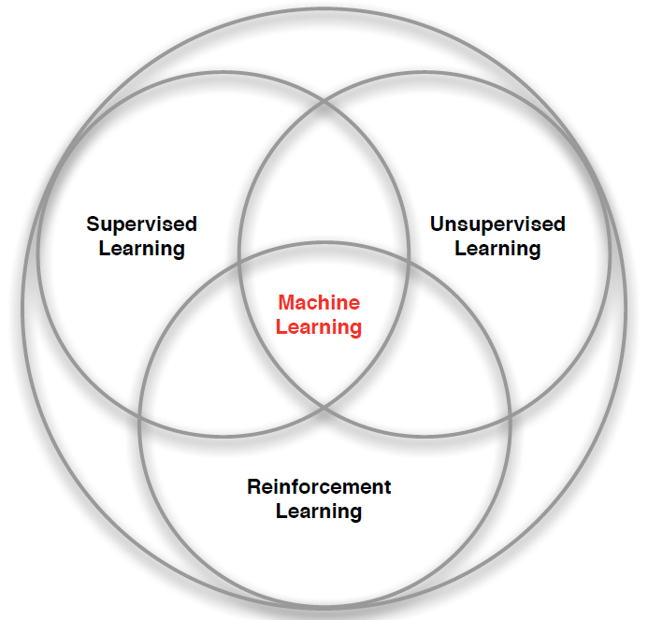
3 Types of Machine Learning
Supervised Learning – Learn a function from labeled data that maps input attributes to an output label e.g., linear regression, decision trees, SVMs.
Unsupervised Learning – Learn patterns in unlabeled data e.g., principle component analysis or clustering algorithms such as K-means, HAC, or Gaussian mixture models.
Reinforcement Learning – An agent learns to maximize rewards while acting in an uncertain environment.
Credit: image borrowed from lecture slides David Silver, DeepMind, “Introduction to Reinforcement Learning

Slide 6
Some Characteristics of Reinforcement Learning
Learning happens as the agent interact with the world.
There are no training or test sets. Training is guided by rewards and punishments obtained by acting in an environment.
The amount of data an agent receives is not fixed. More information is acquired as you go.
Actions are not always rewarded or punished immediately. “Delayed gratification” is possible.
Agent actions can affect the subsequent data it receives. E.g., closing a door that can’t be opened again.

Slide 7
Markov decision processes

Slide 8
MARKOV DECISION PROCESSES
The Markov Decision Process (MDP) provides a mathematical framework for reinforcement learning.
An MDP is used to model optimal decision-making in situations where outcomes are uncertain.
The initial analysis of MDPs assume complete knowledge of states, actions, rewards, transitions, and discounts.
<https://en.wikipedia.org/w/index.php?title=Markov_decision_process&oldid=855934986> [accessed 11 September 2018]

Slide 9
The MDP decision framework
Markov decision processes use probability to model uncertainty about the domain.
Markov decision use utility to model an agent’s objectives. The higher the utility, the “happier” your agent is.
MDP algorithms discover an optimal decision policy π specifying how the agent should act in all possible states in order to maximize its expected utility.

Slide 10
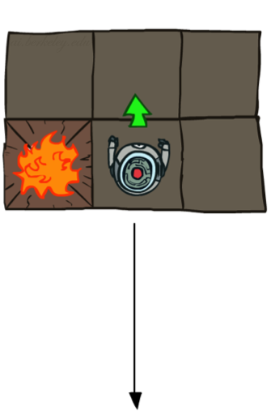
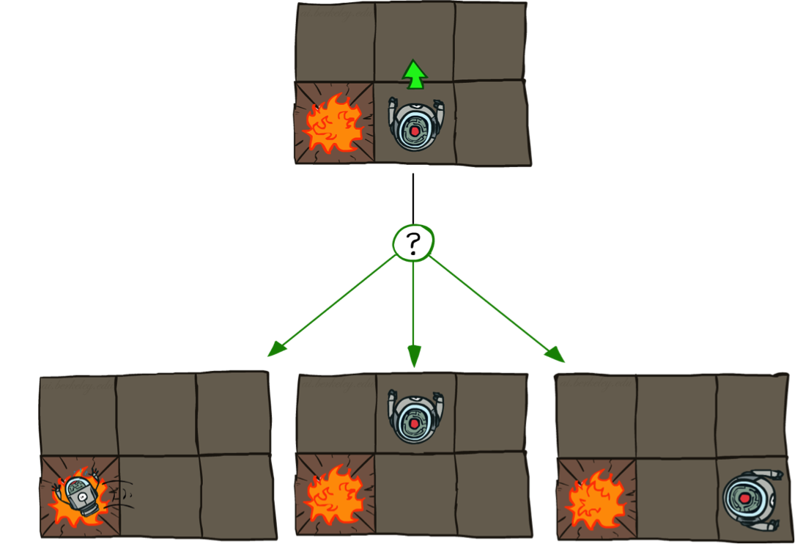
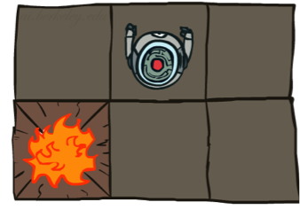
Example: GRID World
Deterministic Grid World
Stochastic Grid World

Slide 11
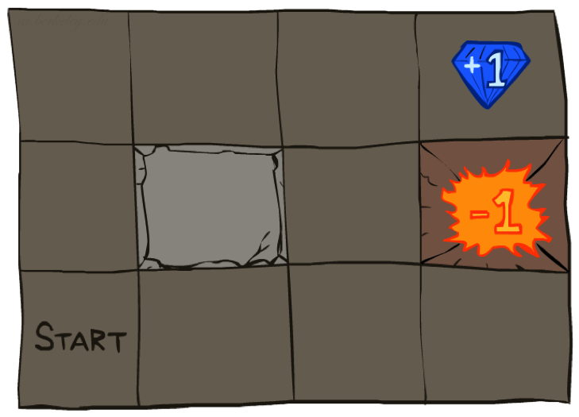




Example: Grid World
A maze-like problem
The agent lives in a grid
Walls block the agent’s path
Noisy movement: actions do not always go as planned
80% of the time, the action North takes the agent North (if there is no wall there)
10% of the time, North takes the agent West; 10% East
If there is a wall in the direction the agent would have been taken, the agent stays put
The agent receives rewards each time step
Small “living” reward each step (can be negative)
Big rewards come at the end (good or bad)
Goal: maximize sum of rewards
Notes:
[cut demo of moving around in grid world program]

Slide 12
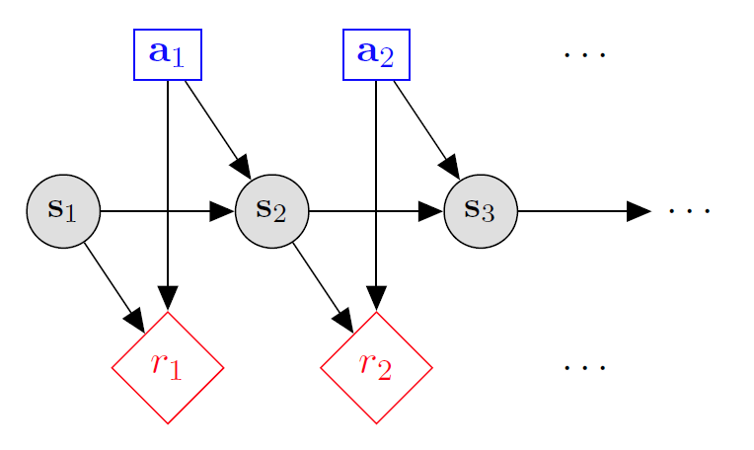

Markov decision processes
States: $s_{1},…,s_{n}$
Actions: $a_{1},…,a_{m}$
Reward Function:
$r\left(s,a,s′\right)∈R$
Transition model:
T(s,a,s’)= $P\left(s′ | s, a\right)$
Discount factor: $γ∈\left[0,1\right]$
<https://en.wikipedia.org/w/index.php?title=Markov_decision_process&oldid=855934986> [accessed 11 September 2018]

Slide 13
MDP Goal: find an optimal policy π

Slide 14
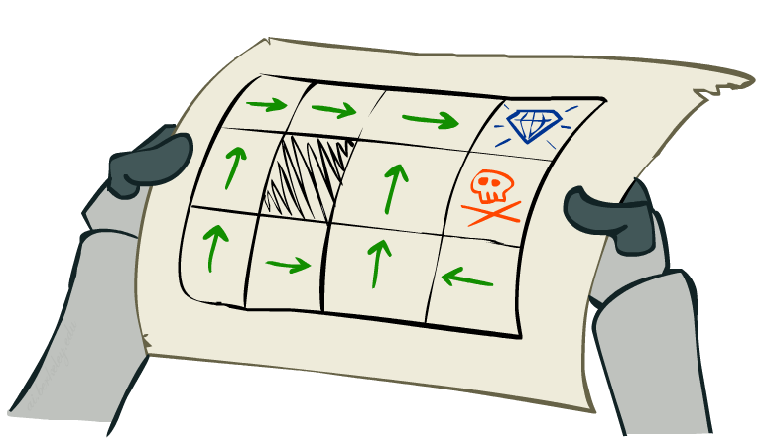

MDP Goal: find an optimal policy π
In a state-space search, we look for an optimal plan, or sequence of actions, from a start state to a goal state.
For MDPs, we look for an optimal policy π*: S → A that completely specifies the best action to take at each state.
A policy π gives an action for each state.
An optimal policy $π^{∗}$ is one that maximizes the expected utility if followed.
Notes:
Dan has a DEMO for this.

Slide 15
Optimal Policies Depend on the Details of the MDP
R(s) = -0.01
R(s) = -0.03
R(s) = -0.4
R(s) = -2.0
Notes:
R(s) = the “living reward”

Slide 16
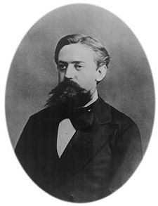
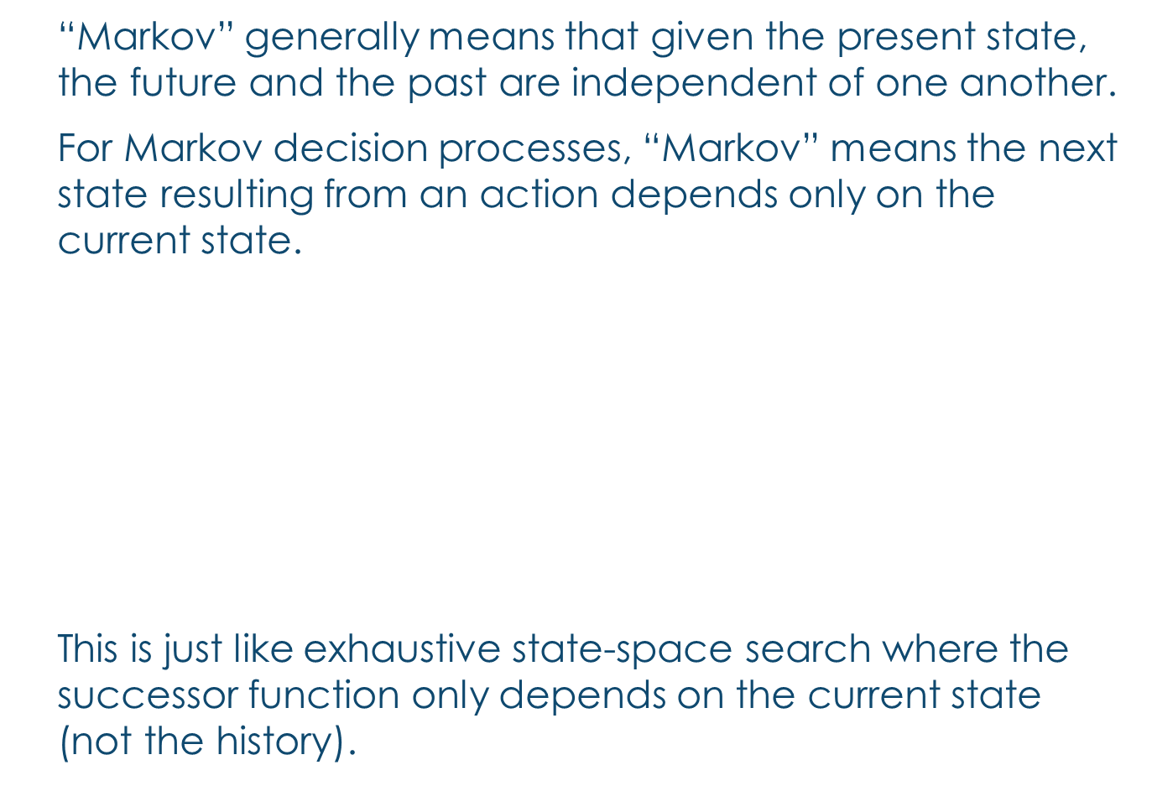
What is Markov about MDPs?
“Markov” generally means that given the present state, the future and the past are independent of one another.
For Markov decision processes, “Markov” means the next state resulting from an action depends only on the current state.
$$P\left(S_{t+1}=s′ | S_{t}=s_{t},A_{t}=a_{t},S_{t−1}=s_{t−1},A_{t−1}=a_{t−1},…,S_{0}=s_{0}\right)$$
=
$$P\left(S_{t+1}=s′ | S_{t}=s_{t},A_{t}=a_{t} \right)$$
This is just like exhaustive state-space search where the successor function only depends on the current state (not the history).
Andrey Markov (1856-1922)
Notes:
Like search: successor function only depended on current state
Can make this happen by stuffing more into the state;
Very similar to search problems: when solving a maze with food pellets, we stored which food pellets were eaten

Slide 17
Data Structures needed for an MDP Algorithm
Representing the MDP:
States S
Actions A
Transitions P(s’|s,a) (or T(s,a,s’))
Rewards R(s,a,s’)
Discount γ
Start states: S
Finish states: F
s
a
s, a
s,a,s’
s’
(s,a,s’) is a transition

Slide 18
Data Structures needed for an MDP Algorithm (2)
Utility - the sum of discounted rewards received so far.
The value (utility) of a state s:
V(s) = expected future utility starting in s and acting optimally,
The q-value (utility) of a q-state (s,a):
Q(s,a) = the future utility expected after taking action a from state s and acting optimally thereafter.
The policy:
π(s) = best action to take from state s
s is a state
s
a
(s, a) is a q-state
s, a
s,a,s’
(s,a,s’) is a transition
s’
[Demo: gridworld values (L9D1)]
Notes:
Demo just shows V and Q values, snapshots on next slides.

Slide 19

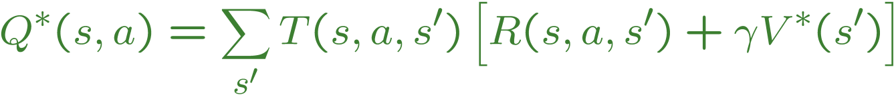

The Bellman Equations
There is one equation $V^{∗}(s)$ for each state s.
There is one equation $Q^{∗}(s,a)$ for each state s and action a.
These are equations, not assignments. They define a relationship, which when satisfied guarantees that $V^{∗}(s)$ and $Q^{∗}\left(s,a\right)$ are optimal for each state and action.
This in turn guarantees that the policy $π^{∗}$is optimal.
s
a
s, a
s,a,s’
s’
Notes:
Let’s start by equations that characterize these quantities through mutual recursions. [step through this by writing on slide, one step at a time]
Recursive characterization of V* in terms of V*; not necessarily helpful; but it is a characterization.
Note: this is a set of equations that needs to be satisfied; but it could have multiple solutions (it does not, but at this stage of our knowledge it could).

Slide 20
4 MDP Algorithms

Slide 21
4 mdp algorithms
Expectimax (recursive, finite horizon)
Value Iteration (dynamic programming, finite horizon)
Value Iteration (dynamic programming, infinite horizon)
Policy Iteration (dynamic programming, infinite horizon,
optimize policy)

Slide 22
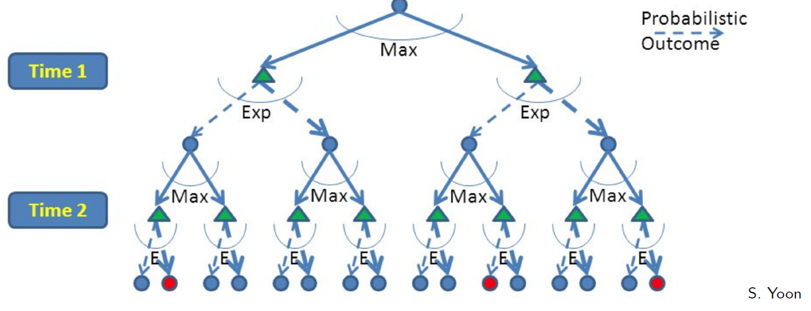
Expectimax: A game against Nature
Expectimax is like a game-playing algorithm except the opponent is nature.
Expectimax is strongly related to the minmax algorithm used in game theory, but the response is probabilistic.
Nodes where you move are called states: S ( )
Nodes where nature moves are called Q-states: <S,A> ( )

Slide 23
Expectimax: top-down, Recursive
Expectimax is basically a planning algorithm.
It finds the best move for 1 state.
Build out a look-ahead tree to the decision horizon; take the max over actions, expectations over next states.
Solve from the leaves, backing-up the expectimax values.

Slide 24
Expectimax: top-down, Recursive
Advantages:
- Effective in rapidly changing environment where the MDP is known.
Disadvantages:
- computation is exponential in the horizon.
- may expand the same subtree multiple times.

Slide 25
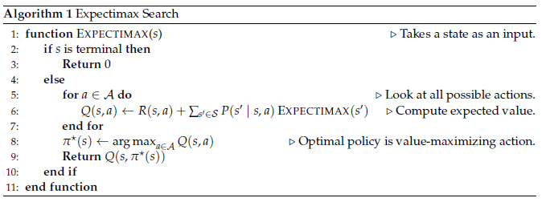
Expectimax algorithm

Slide 26
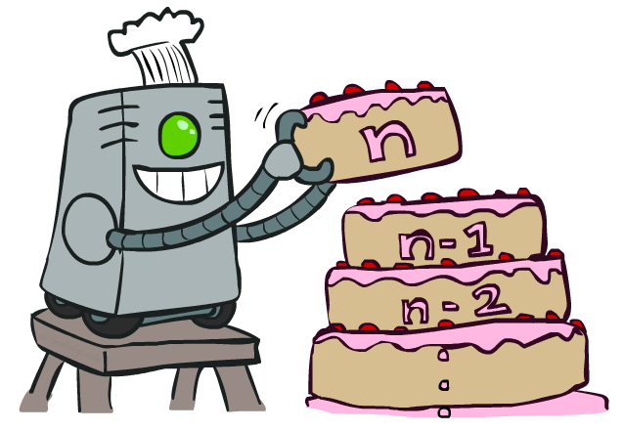
Value Iteration uses dynamic programming

Slide 27

Value Iteration (Finite Horizon)
Start with V₀(s) = 0 - no time steps left means an expected reward sum of zero
Given vector of V_{k}(s) values, do one ply from each state:
$V_{k+1}\left(s\right)←\max_{a}\left[\sum_{s^{′}}{P\left(s^{′} | s,a\right)\left[R\left(s,a,s′\right)+{γV}_{k}\left(s^{′}\right)\right]}\right]$
Repeat until k == T
--------------------------------------------------------------------------------------------
Complexity of each iteration: O(S²A)
For every state s, there are |A| actions
For every state s and action a, there are |S| possible states s’
Notes:
Discuss computational complexity: S * A * S times number of iterations
Note: updates not in place [if in place, it means something else and not even clear what it means]

Slide 28
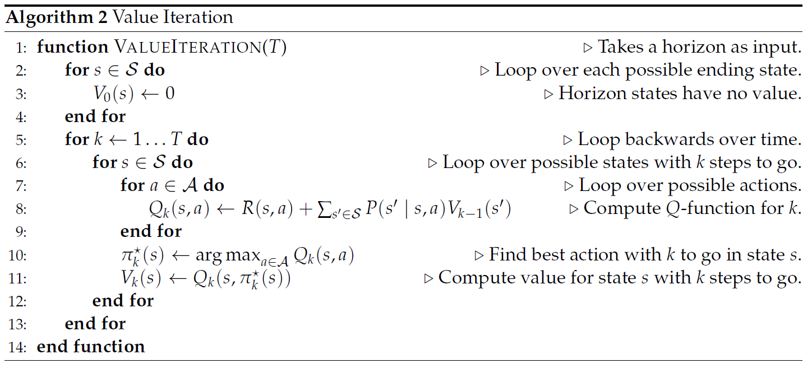
Value iteration (Finite Horizon)

Slide 29
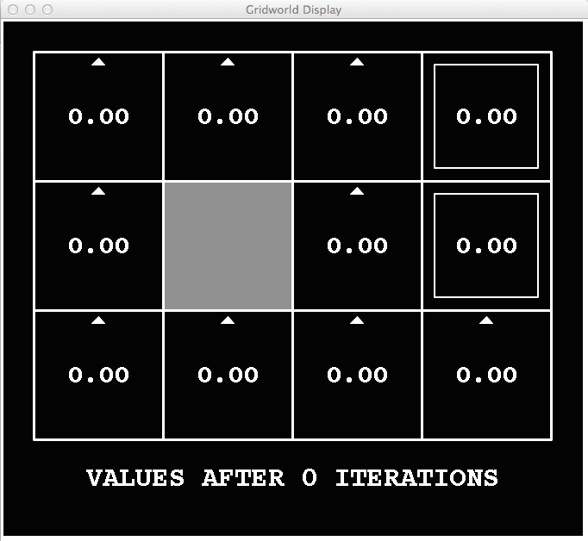
k=0
Noise = 0.2
Discount = 0.9
Living reward = 0
Notes:
Assuming zero living reward

Slide 30
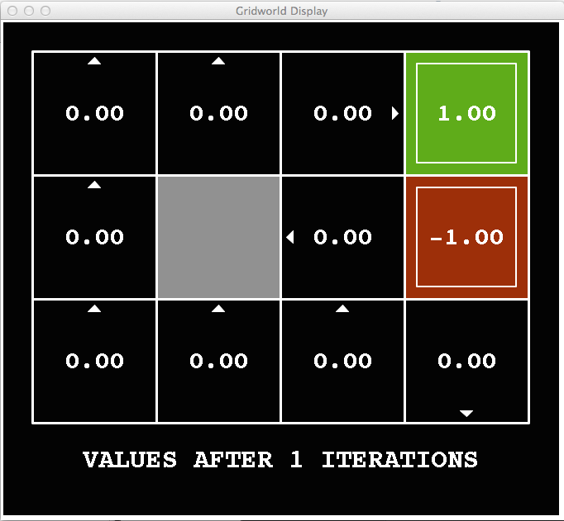
k=1
Noise = 0.2
Discount = 0.9
Living reward = 0
Notes:
Assuming zero living reward

Slide 31
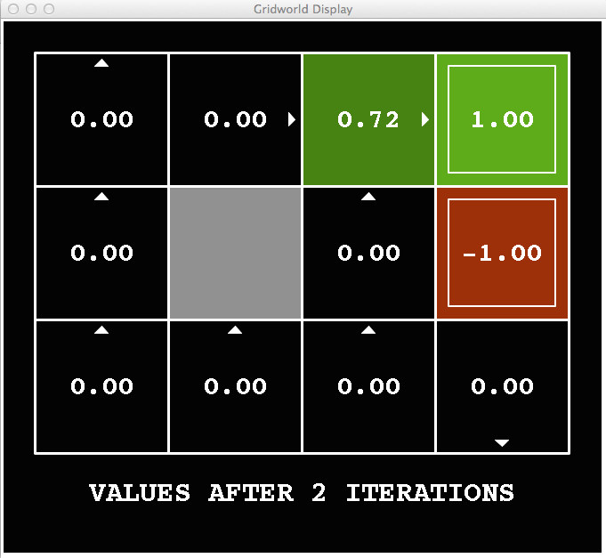
k=2
Noise = 0.2
Discount = 0.9
Living reward = 0
Notes:
Assuming zero living reward

Slide 32
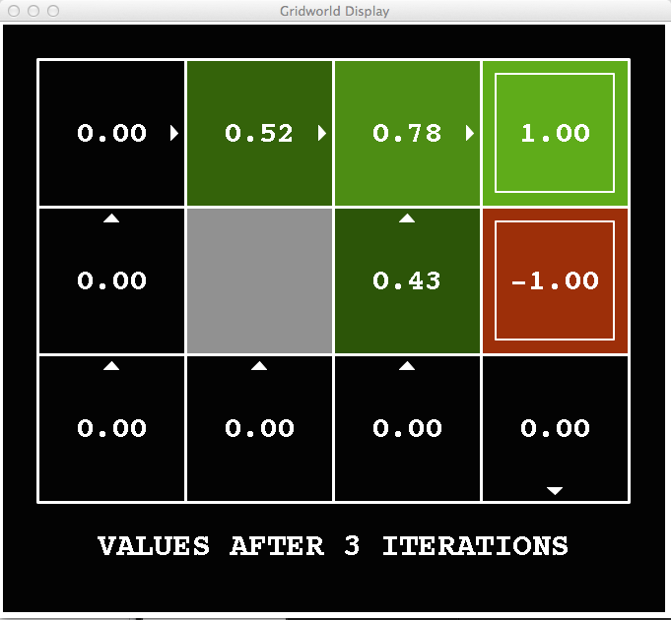
k=3
Noise = 0.2
Discount = 0.9
Living reward = 0
Notes:
Assuming zero living reward

Slide 33

Value Iteration (Infinite Horizon)
Start with V₀(s) = 0 - no time steps left means an expected reward sum of zero
Given vector of V_{k}(s) values, do one ply from each state:
$V_{k+1}\left(s\right)←\max_{a}\left[\sum_{s^{′}}{P\left(s^{′} | s,a\right)\left[R\left(s,a,s′\right)+{γV}_{k}\left(s^{′}\right)\right]}\right]$
Repeat until convergence
--------------------------------------------------------------------------------------------
Theorem: will converge to unique optimal values
Basic idea: approximations get refined towards optimal values
Policy may converge long before values do
Notes:
Discuss computational complexity: S * A * S times number of iterations
Note: updates not in place [if in place, it means something else and not even clear what it means]

Slide 34
k=0
Noise = 0.2
Discount = 0.9
Living reward = 0
Notes:
Assuming zero living reward

Slide 35
k=1
Noise = 0.2
Discount = 0.9
Living reward = 0
Notes:
Assuming zero living reward

Slide 36
k=2
Noise = 0.2
Discount = 0.9
Living reward = 0
Notes:
Assuming zero living reward

Slide 37
k=3
Noise = 0.2
Discount = 0.9
Living reward = 0
Notes:
Assuming zero living reward

Slide 38
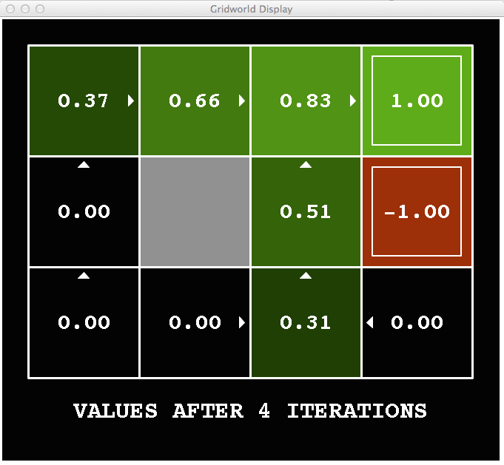
k=4
Noise = 0.2
Discount = 0.9
Living reward = 0
Notes:
Assuming zero living reward

Slide 39
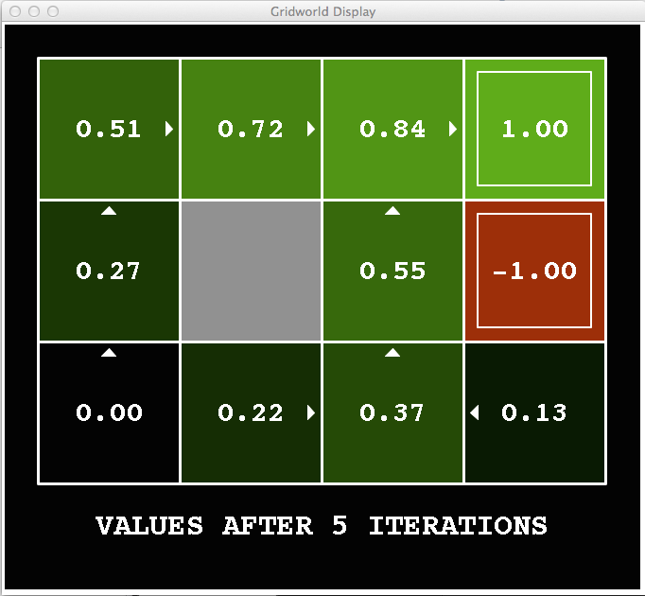
k=5
Noise = 0.2
Discount = 0.9
Living reward = 0
Notes:
Assuming zero living reward

Slide 40
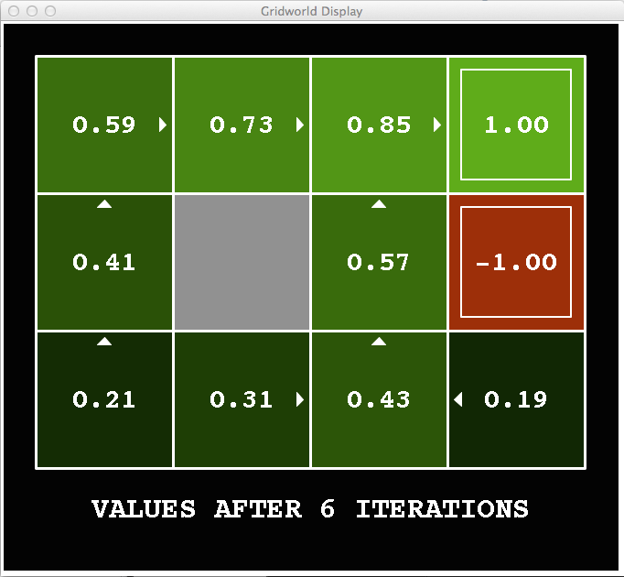
k=6
Noise = 0.2
Discount = 0.9
Living reward = 0
Notes:
Assuming zero living reward

Slide 41
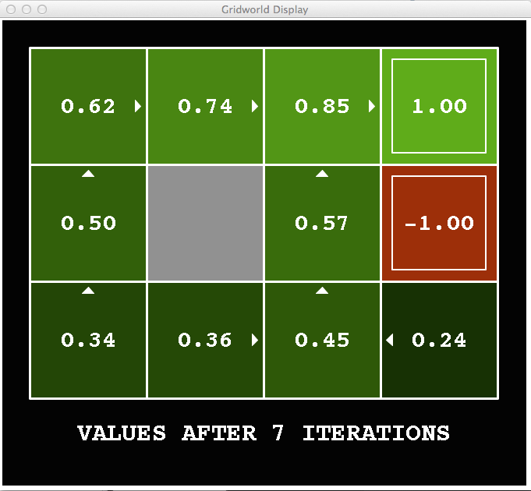
k=7
Noise = 0.2
Discount = 0.9
Living reward = 0
Notes:
Assuming zero living reward

Slide 42
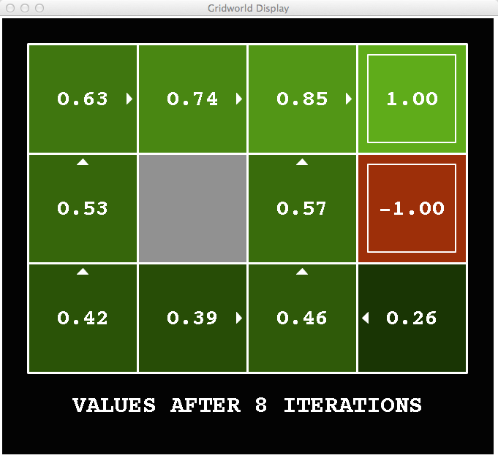
k=8
Noise = 0.2
Discount = 0.9
Living reward = 0
Notes:
Assuming zero living reward

Slide 43
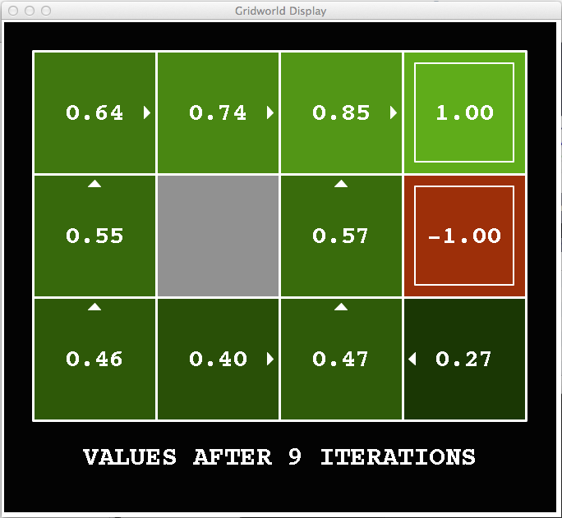
k=9
Noise = 0.2
Discount = 0.9
Living reward = 0
Notes:
Assuming zero living reward

Slide 44

k=10
Noise = 0.2
Discount = 0.9
Living reward = 0
Notes:
Assuming zero living reward

Slide 45

k=11
Noise = 0.2
Discount = 0.9
Living reward = 0
Notes:
Assuming zero living reward

Slide 46
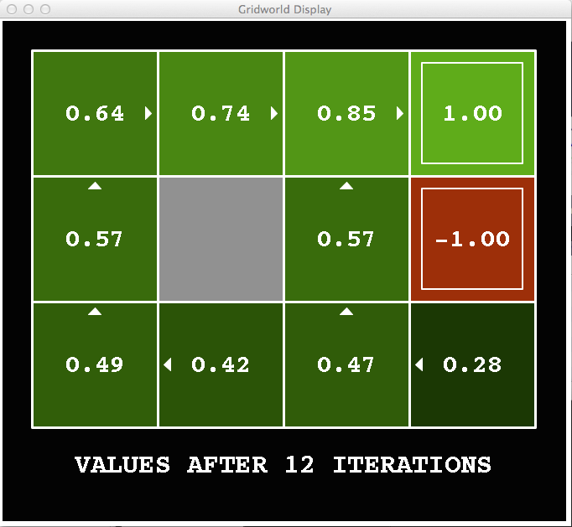
k=12
Noise = 0.2
Discount = 0.9
Living reward = 0
Notes:
Assuming zero living reward

Slide 47

k=100
Noise = 0.2
Discount = 0.9
Living reward = 0
Notes:
Assuming zero living reward

Slide 48
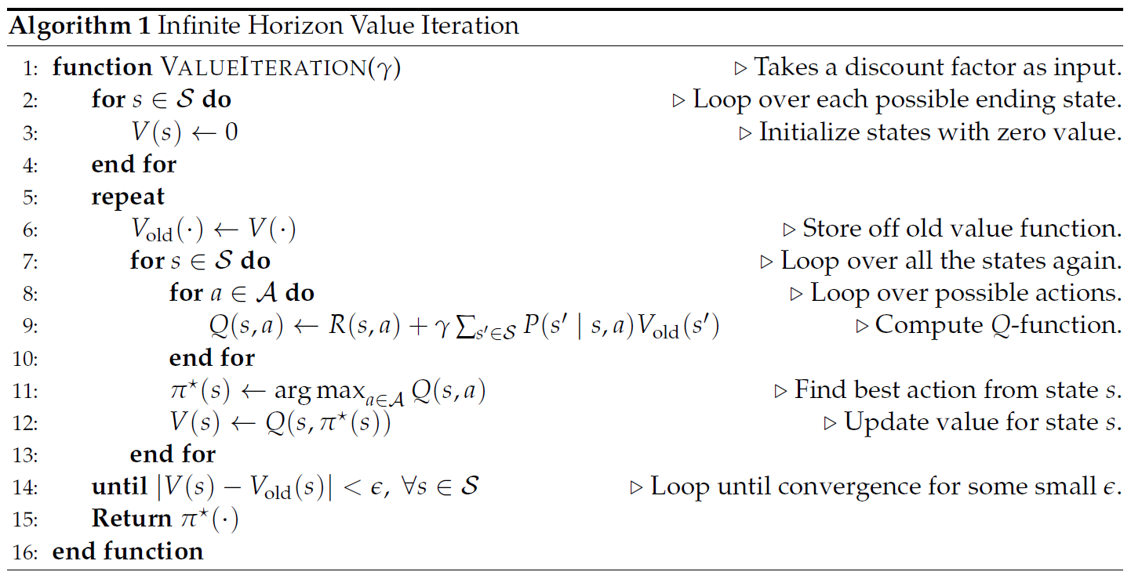
Value iteration (Infinite Horizon)

Slide 49
Policy Iteration
Alternative approach for optimal values:
Step 1: Policy evaluation: calculate utilities for some fixed policy (not optimal utilities!) until convergence
Step 2: Policy improvement: update policy using one-step look-ahead with resulting converged (but not optimal!) utilities as future values
Repeat steps until new policy is the same as the old policy.
This is policy iteration
It’s still optimal!
Can converge (much) faster under some conditions

Slide 50
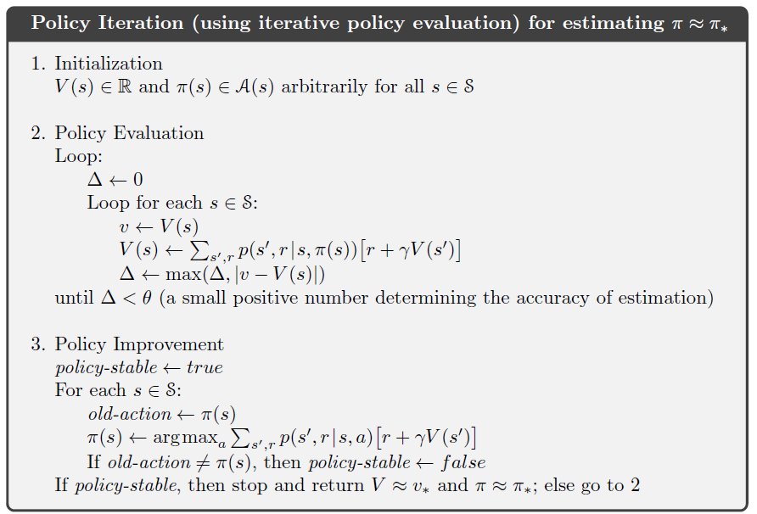

Slide 51
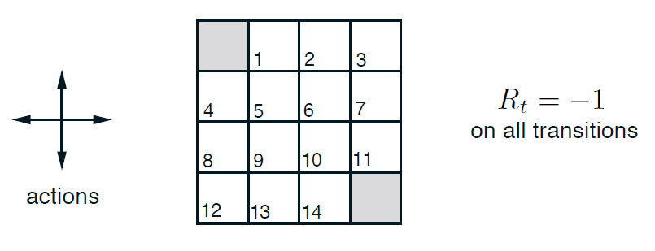
policy iteration EXAMPLE

Slide 52
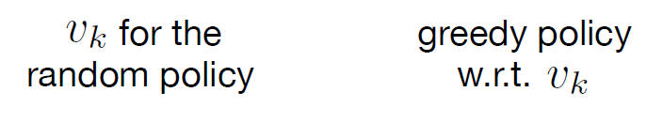
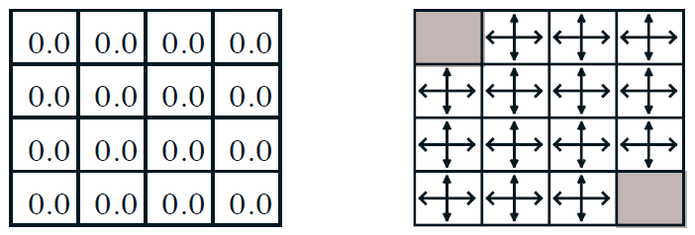
policy iteration EXAMPLE (k=0)

Slide 53
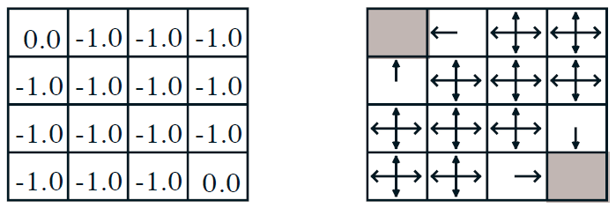
policy iteration EXAMPLE (k=1)

Slide 54
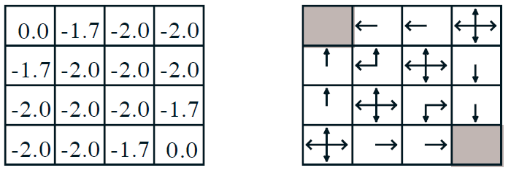
policy iteration EXAMPLE (k=2)

Slide 55
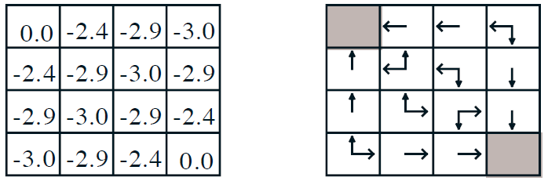
policy iteration EXAMPLE (k=3, Optimal)

Slide 56
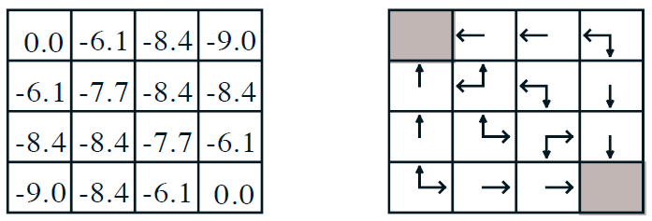
policy iteration EXAMPLE (k=10, Optimal)

Slide 57
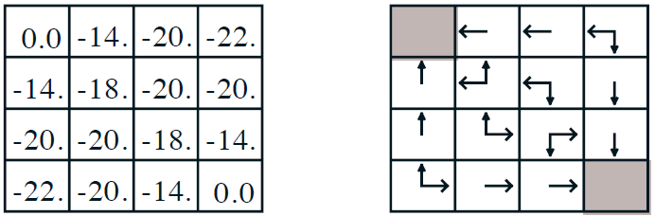
policy iteration EXAMPLE (k=$∞$, Optimal)

Slide 58
Model-based reinforcement learning

Slide 59
Reinforcement Learning
Agent
State: s’
Reward: r
Actions: a
Environment
Agent knows the current state s, takes action a, receives a reward r and observes the next state s’
Agent has no access to reward model r(s,a) or transition model p(s’|s,a)
Agent must learn to act so as to maximize expected rewards.
All learning is based on observed samples of outcomes!
Under these conditions, it is a very challenging problem to learn the policy π.

Slide 60




Model-Based Learning
Model-Based Idea:
Learn an approximate model based on experiences
Solve for values as if the learned model were correct
Step 1: Learn empirical MDP model
Count outcomes s’ for each s, a
Normalize to give an estimate of
Discover each when we experience (s, a, s’)
Step 2: Solve the learned MDP
For example, use value iteration, as before

Slide 61

Learn the reward and transition distributions
Try every action in each state a number of times
$RTotal\left(s,a,s^{′}\right)=$total reward for taking action a in state s and transitioning to state s’
$N\left(a,s\right)=$ number of times action a is taken in state s
$N\left(s,a,s^{′}\right)=$ number of times s transitions to s’ on action a
$\hat{R}\left(s,a,s^{′}\right)=RTotal(s,a,s^{′})/N(s,a,s^{′})$
$\hat{T}\left(s,a,s^{′}\right)=N(s,a,s^{′})/N(a,s)$

Slide 62
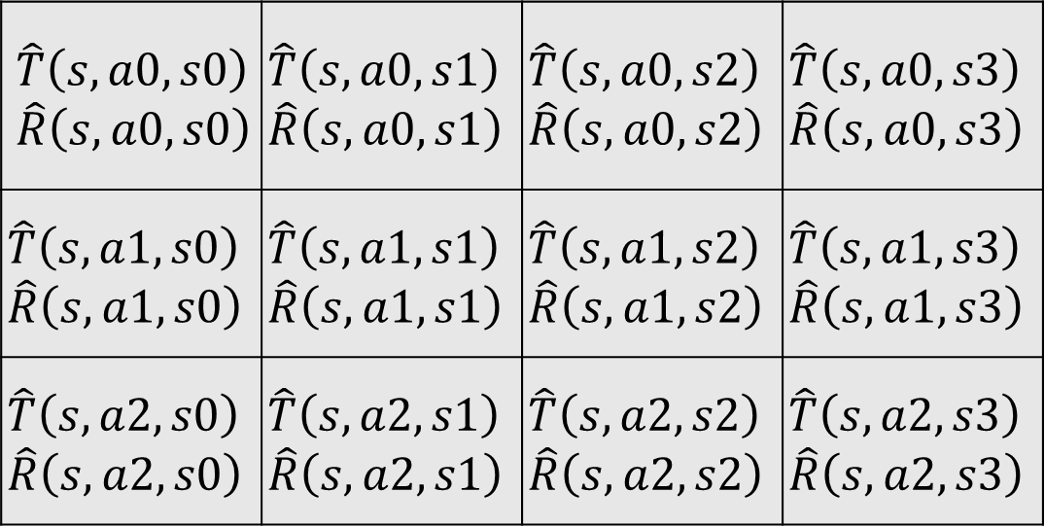
Transition/reward parameter table
For every state s:
State s’
$$\hat{T}\left(s,a0,s0\right)$$ $$\hat{R}\left(s,a0,s0\right)$$ | $$\hat{T}\left(s,a0,s1\right)$$ $$\hat{R}\left(s,a0,s1\right)$$ | $$\hat{T}\left(s,a0,s2\right)$$ $$\hat{R}\left(s,a0,s2\right)$$ | $$\hat{T}\left(s,a0,s3\right)$$ $$\hat{R}\left(s,a0,s3\right)$$
$$\hat{T}\left(s,a1,s0\right)$$ $$\hat{R}\left(s,a1,s0\right)$$ | $$\hat{T}\left(s,a1,s1\right)$$ $$\hat{R}\left(s,a1,s1\right)$$ | $$\hat{T}\left(s,a1,s2\right)$$ $$\hat{R}\left(s,a1,s2\right)$$ | $$\hat{T}\left(s,a1,s3\right)$$ $$\hat{R}\left(s,a1,s3\right)$$
$$\hat{T}\left(s,a2,s0\right)$$ $$\hat{R}\left(s,a2,s0\right)$$ | $$\hat{T}\left(s,a2,s1\right)$$ $$\hat{R}\left(s,a2,s1\right)$$ | $$\hat{T}\left(s,a2,s2\right)$$ $$\hat{R}\left(s,a2,s2\right)$$ | $$\hat{T}\left(s,a2,s3\right)$$ $$\hat{R}\left(s,a2,s3\right)$$
Action a

Slide 63
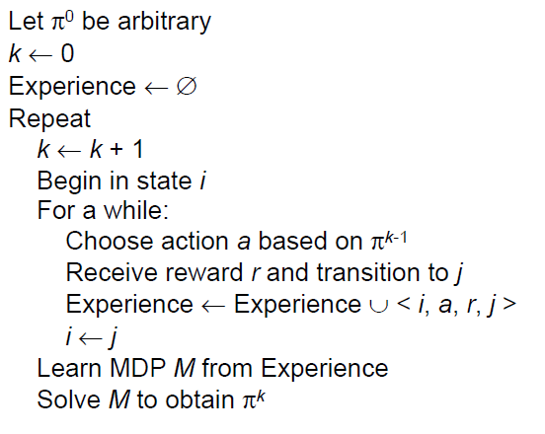
Model-based RL

Slide 64
Model-based rl: Pros and cons
Pros:
Makes maximal use of experience
Solves model optimally, given enough experience
Cons:
Model must be small enough to solve.
Solution procedure is computationally expensive.
Learning is episodic, not continuous, so agent does not benefit immediately from experience.
Conclusion:
Model-free approaches are used for most real-world problems.
Examples: Q-Learning, Monte Carlo, SARSA, TD-Learning, Deep QL, etc.

